Slide 1
The Earth’s Varying Climates

Slide 2
What factors create local climates and how does this affect distribution of species?
Learning objectives
The Earth’s spheres
Weather vs climate
Creating local climates
Where are organisms?
To answer this question, we will:
Learn the difference between weather and climate
Explore how differences in various factors, such as latitude and landcover, affect a location’s climate
Investigate how rain shadows and proximity to water affect rainfall
Discuss how the distribution of plants and animals are affected by climate

Slide 3
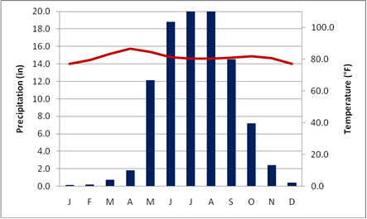

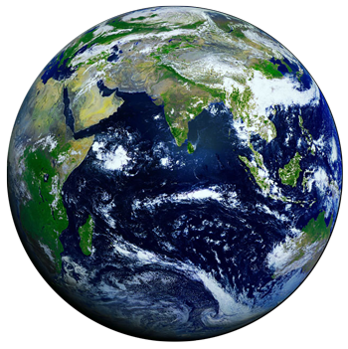


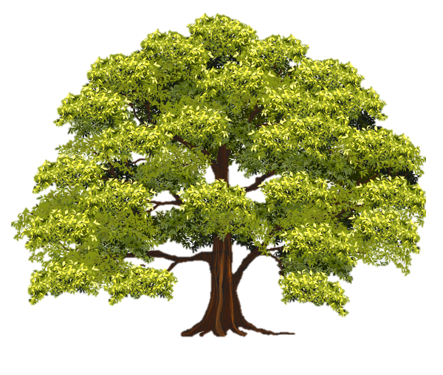



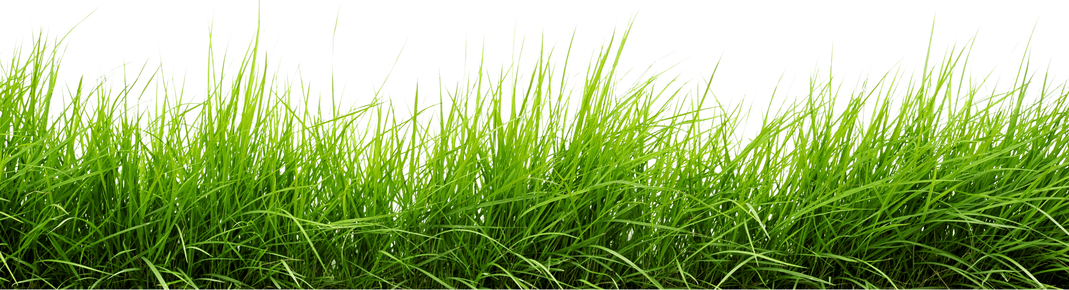
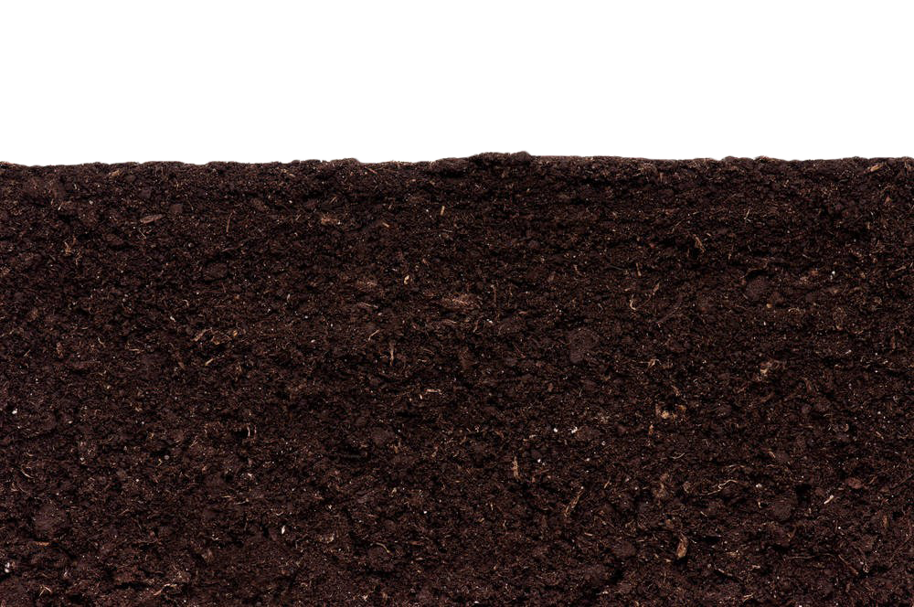
Weather vs Climate
Learning objectives
Weather vs climate
The Earth’s spheres
Creating local climates
Where are organisms?
Weather
Short-term state of the atmosphere
Can change within minutes or hours
Climate
Long-term weather patterns
Weather averaged over many years in one specific place
Notes:
*slide is animated for weather and then climate*
Weather and climate are two terms that are often used interchangeably, but they are two separate ideas.
Weather is the short-term state of the atmosphere and can change within minutes or hours. An example of weather is when it is raining in the morning and sunny in the afternoon. These are relatively quick changes in the conditions of the atmosphere.
Climate, on the other hand, is the long term patterns in weather at a specific place. This is called a climograph and it shows us the average temperature and rainfall for each month of the year for one location. This example is a location in India that experiences a rainy season between May and October and relatively warm temperatures all year round. This is a consistent pattern that reoccurs every year.

Slide 4
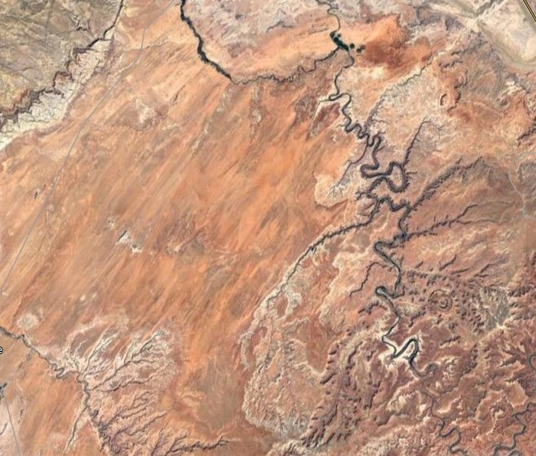

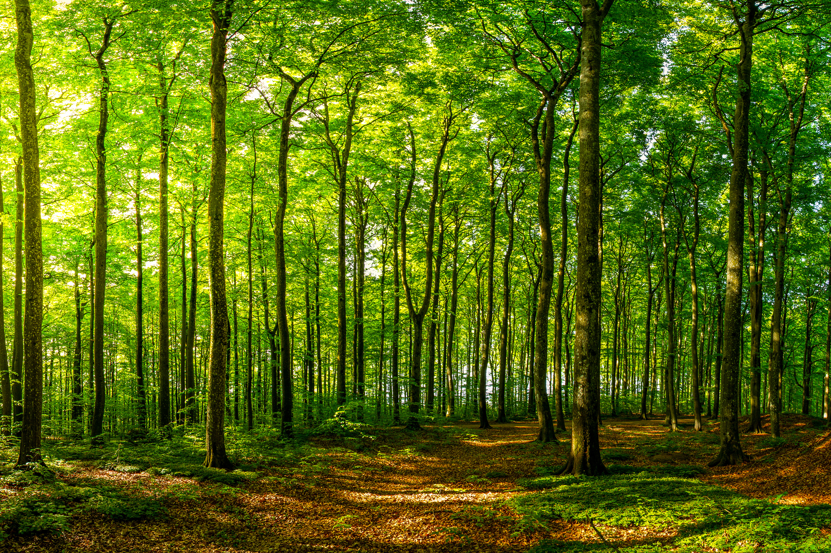
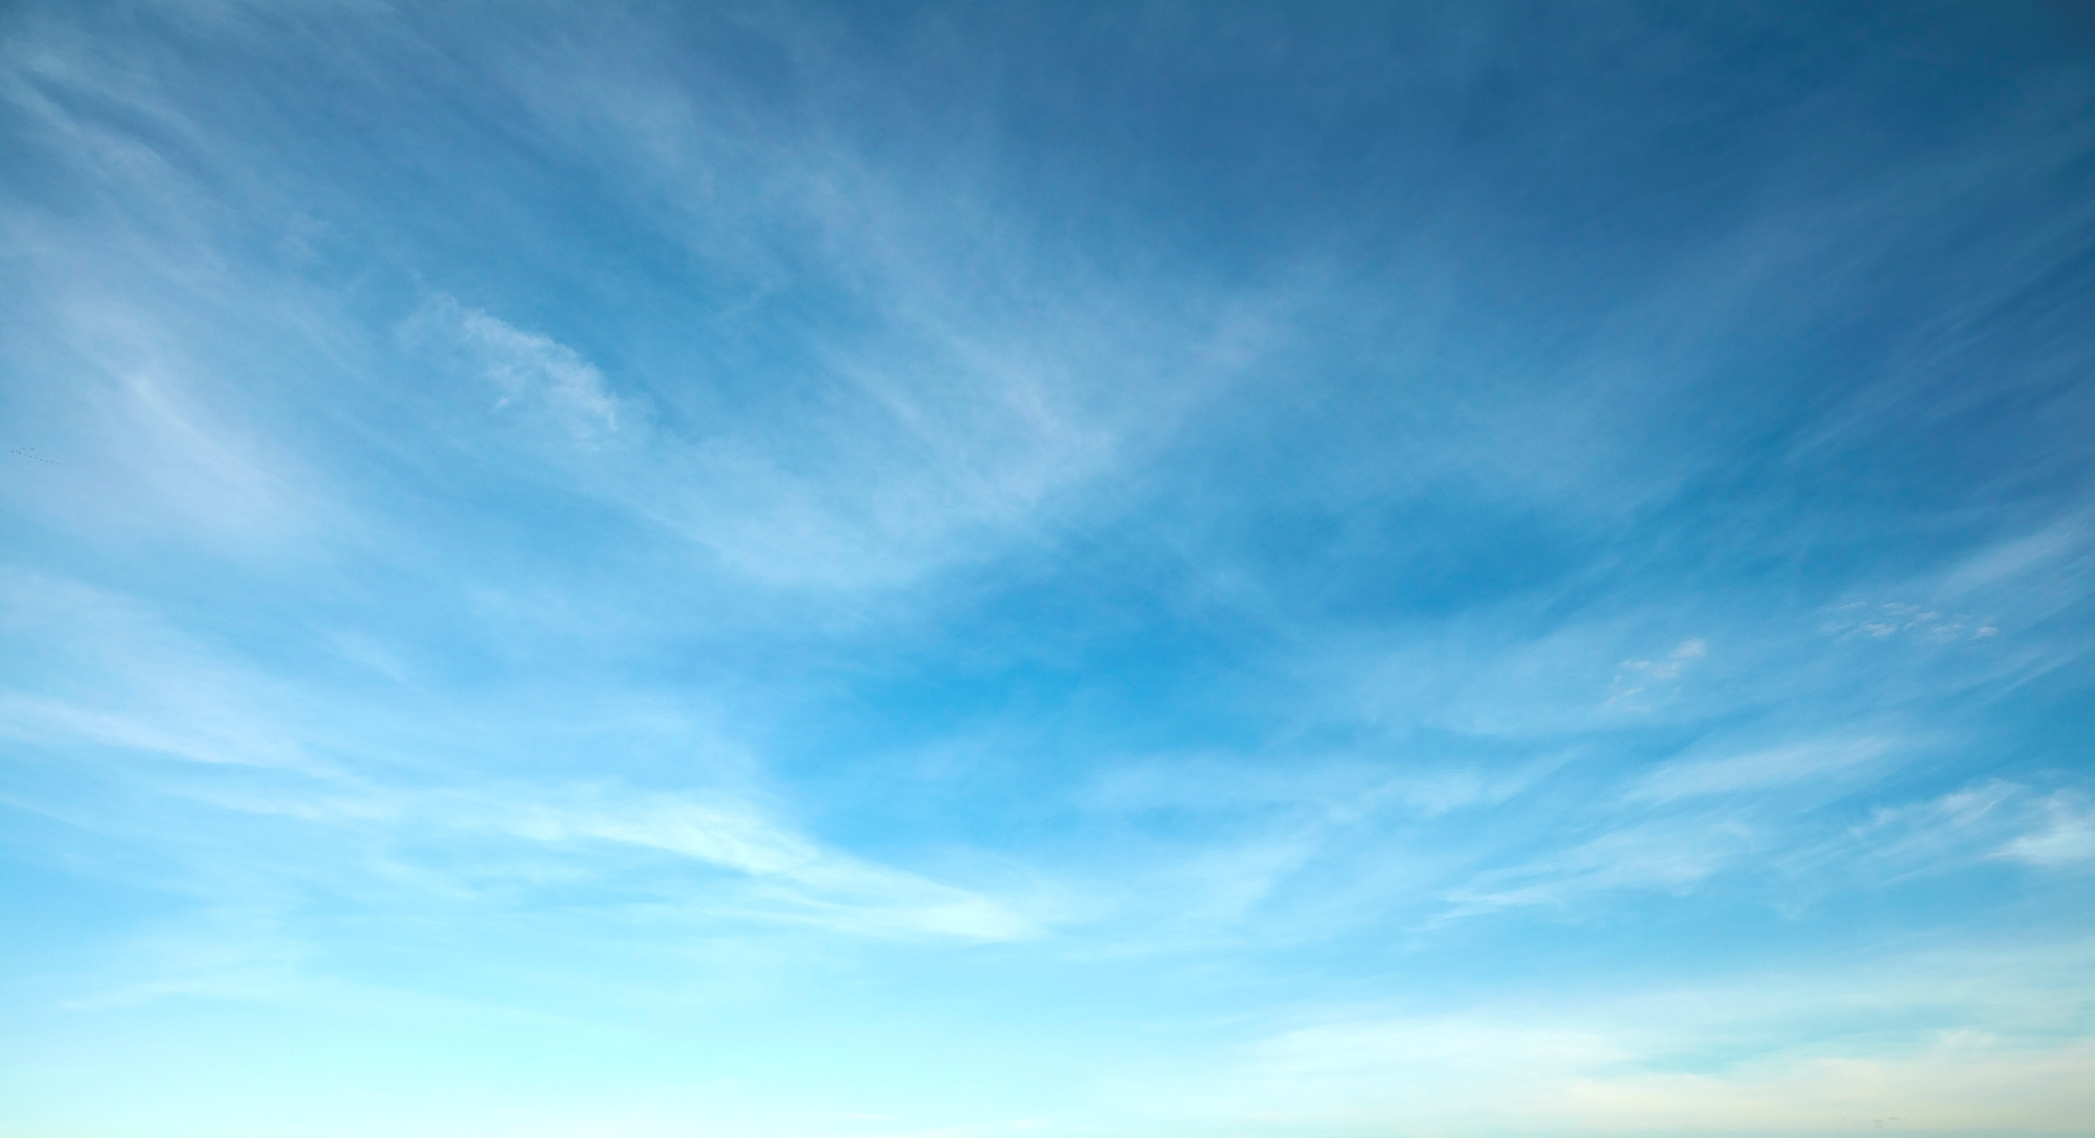
The Earth’s Spheres
Learning objectives
Weather vs climate
The Earth’s spheres
Creating local climates
Where are organisms?
Lithosphere
Earth’s upper mantle and crust
Hydrosphere
Water in all forms
The spheres interact to create local climates
Biosphere
All living things
Atmosphere
Mix of gases surrounding the Earth
Notes:
*NOTE: This slide is animated*
There are four major “spheres” on earth:
The Lithosphere includes the upper mantle and earth’s crust. We can think of this as natural landscape features such as mountains and valleys.
The Hydrosphere contains water in all forms, including water vapor, ice, fresh or salt water, glaciers, rivers, and so forth.
The Atmosphere is a mix of gases surrounding the earth that is held in by gravity.
The Biosphere includes all living things. While we often refer to this as the “zone of life,” the biosphere requires water and energy sources, so it also includes the physical environment.
These spheres interact to create local climates!

Slide 5
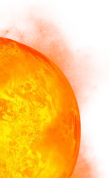
Creating Local Climates
Learning objectives
Weather vs climate
The Earth’s spheres
Creating local climates
Where are organisms?
Latitude
Total solar radiation received varies by latitude
Sunlight is most direct and intense near the Equator, creating a warm, tropical climate
Sunlight is more diffuse near the poles, creating a cold, polar climate
Notes:
*NOTE: Slide is animated*
Latitude effects the amount of insolation (incoming solar radiation) received
At and around the equator, sunlight is most direct and intense, adding more energy to the atmosphere and creating warm, tropical climates
Sunlight travels further and spread across a larger space on earth, causing more diffuse radiation at the poles, creating a cold, polar climate

Slide 6

Creating Local Climates
Learning objectives
Weather vs climate
The Earth’s spheres
Creating local climates
Where are organisms?
Instability
Locations with direct and intense sunlight warm quickly!
Warm air rises and cools
Clouds and potentially storms form, creating a consistently warm and rainy climate
Notes:
*Note: this slide is animated – arrow and clouds*
Areas near the equator receive this direct and intense sunlight.
This creates warm air.
Warm air rises, cools, and condenses, forming clouds and potentially storms.
This results in a consistently wet and warm climate.

Slide 7
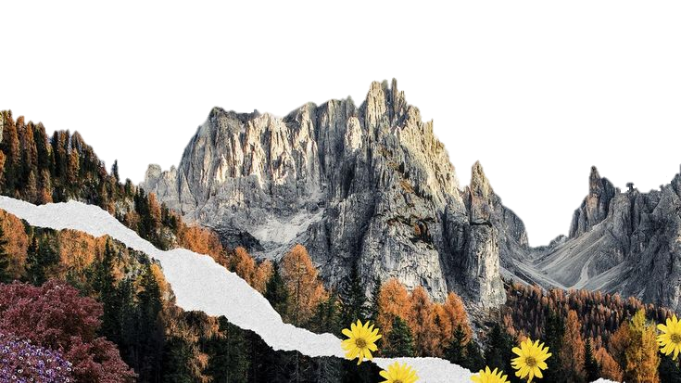
Creating Local Climates
Learning objectives
Weather vs climate
The Earth’s spheres
Creating local climates
Where are organisms?
Altitude
Air thins and cools as it rises, creating cooler climates at higher altitudes
Cooler, higher altitude
Warmer,
lower altitude
Notes:
*NOTE: Arrow and “warmer/cooler” are animated*
The higher the altitude or elevation, the further the air is traveling from the heating source (the earth’s surface!) and the air is thinning. The air is unable to hold as much heat when it is thinner. Likewise, as air rises away from the heating source, it is expanding and cooling.

Slide 8

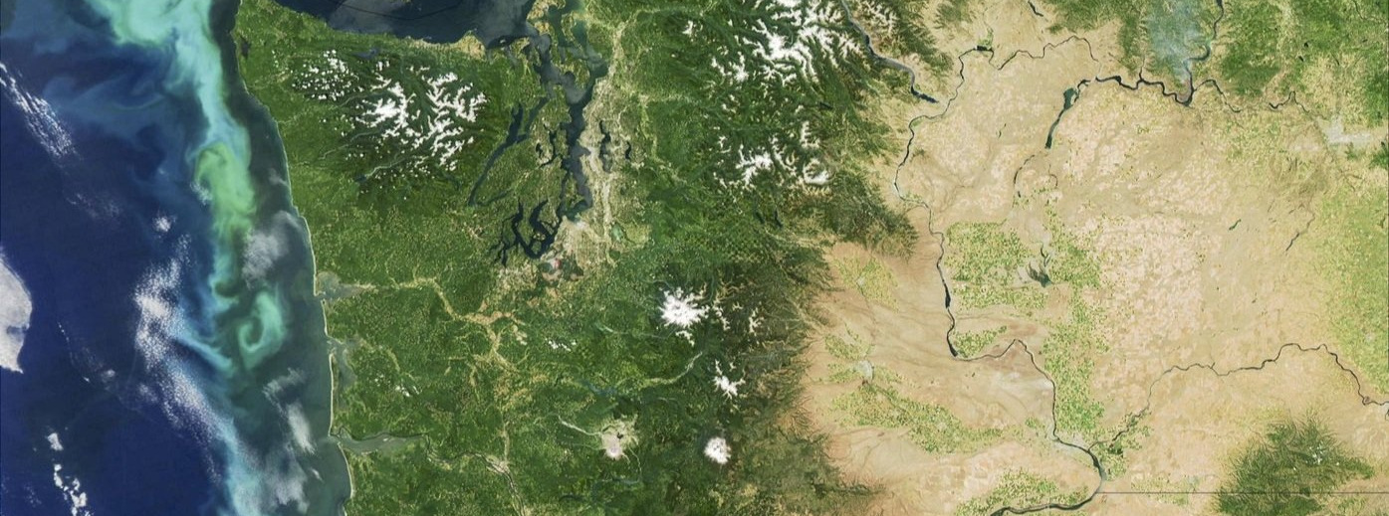


Creating Local Climates
Learning objectives
Weather vs climate
The Earth’s spheres
Creating local climates
Where are organisms?
Rain Shadows
The windward side of mountains and volcanoes forces air up, cooling and forming clouds and rain, creating a wet climate
As the air flows down the leeward side of the mountain, it compresses and warms, creating a dry climate
Windward
Leeward
Wind direction
Notes:
*NOTE: Animated slide!*
In areas where we have high elevation, like here in Washington State with the Cascade Mountain Range, we can form rainshadows.
The side of the mountain that the wind hits first is the windward side, forces the air up where it condenses and forms clouds and rain. This creats
FINISH ME

Slide 9
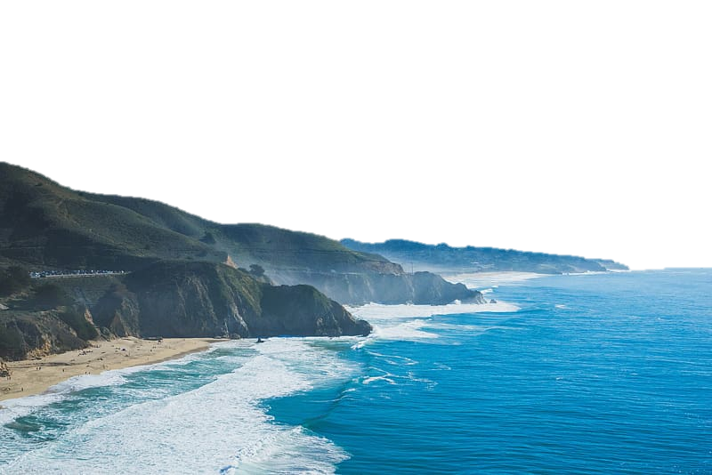
Creating Local Climates
Learning objectives
Weather vs climate
The Earth’s spheres
Creating local climates
Where are organisms?
Proximity to water
Water changes temperature more slowly than land, creating moderate temperature climates for nearby areas
Inland areas heat and cool quickly, creating larger ranges in temperature daily and annually
Being close to water can result in more precipitation and wetter climates
Wind direction
Notes:
*NOTE: This is valid for most locations, but especially for locations that receive their winds off a large water body*
*Arrow is animated*
Water heats and cools more slowly than land (high specific heat) so it won’t change temperature as quickly. This will cause a moderating effect on temperatures in nearby land areas.
Areas in the middle of a continent will heat and cool very quickly, causing larger ranges in temperatures daily and annually – more seasonal weather.
If there is a water source nearby, this can be a source of moisture to create a wetter climate.

Slide 10
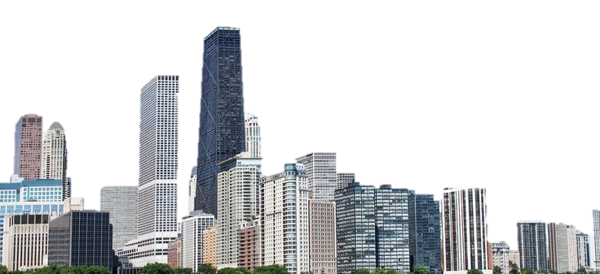
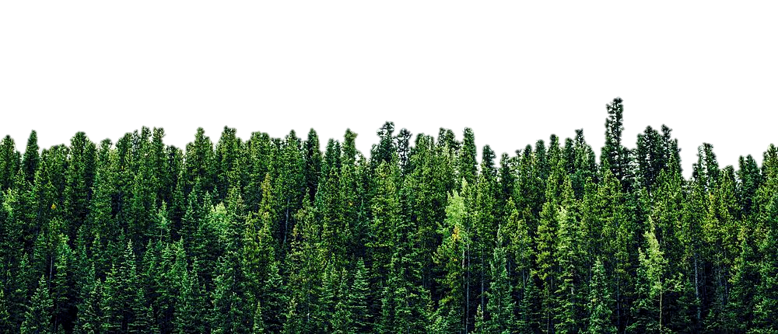
Creating Local Climates
Learning objectives
Weather vs climate
The Earth’s spheres
Creating local climates
Where are organisms?
Land Cover
Surfaces retain and reflect heat differently
Urban areas retain heat well, creating a warmer climate
Vegetated and rural areas release heat well, creating a cooler climate
Notes:
Land cover will affect how energy and heat is retained and reflected.
Urban areas contain heat absorbing materials and densely packed structures that can hold heat close to the earth’s surface, creating a warming effect.
In rural areas, warm air is more easily mixed with cooler air aloft and vegetation cools through evapotranspiration, creating a cooler climate (as compared to urban areas).

Slide 11
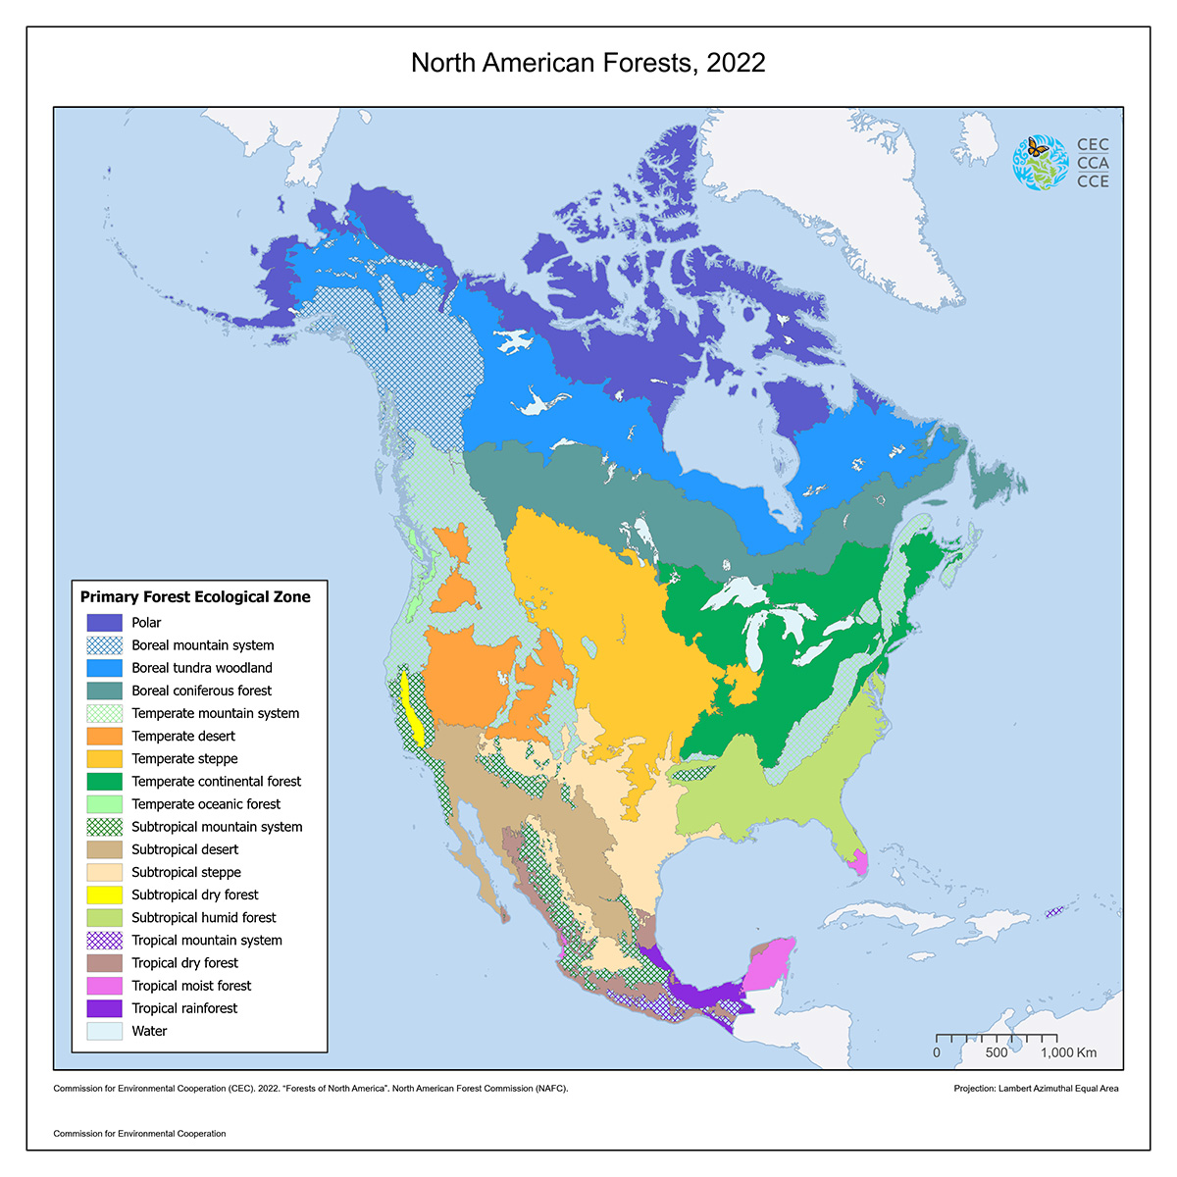
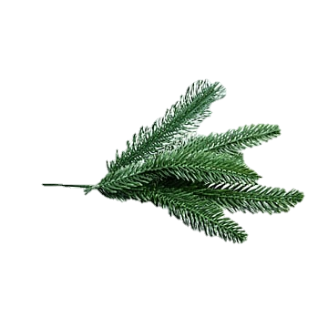
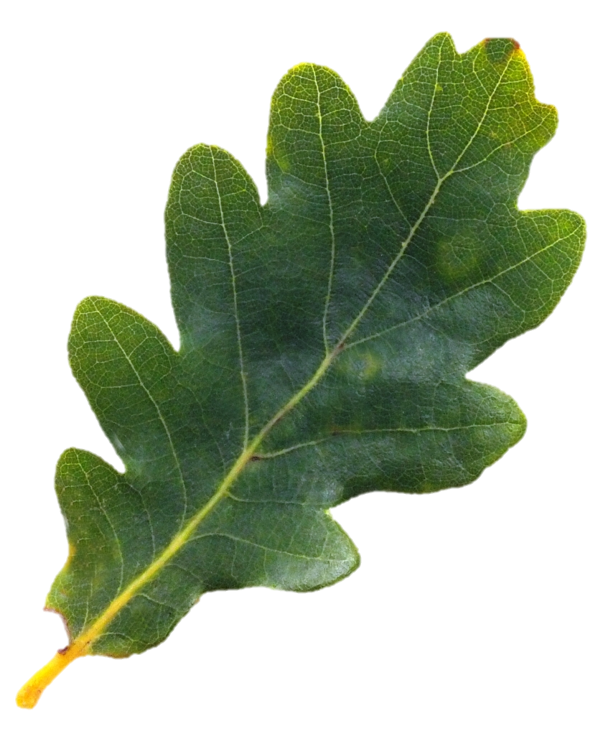
Distribution of Plants
Learning objectives
Weather vs climate
The Earth’s spheres
Creating local climates
Where are organisms?
Dependent on sunlight, humidity, temperature, soil, water availability
Broadleaf Trees
Wide, flat leaves
Lose leaves in colder and/or drier weather
Occur in areas where there are enough nutrients, sunlight, and water to produce new leaves every spring
Needleleaf Trees
Thin leaves (needles) that retain moisture and are resistant to wind
Do not fall seasonally, capture sunlight all year
Occur in colder, drier areas
Notes:
We can connect the distribution of organisms with global and local climates
The distribution of plants depend on how much sunlight, water, and heat there is, as well as soil types
Broadleaf trees, for instance, have wide, flat leaves that fall during cooler and/or drier seasons. These types of trees will occur where there is enough nutrients, sunlight, and water to produce new trees every year
Needleleaf trees have thin leaves (AKA) needles that stay on the tree all year to absorb sunlight. They have a waxy coating that helps to retain moisture and needles are generally more resistant to wind. These trees occur in colder, drier areas

Slide 12
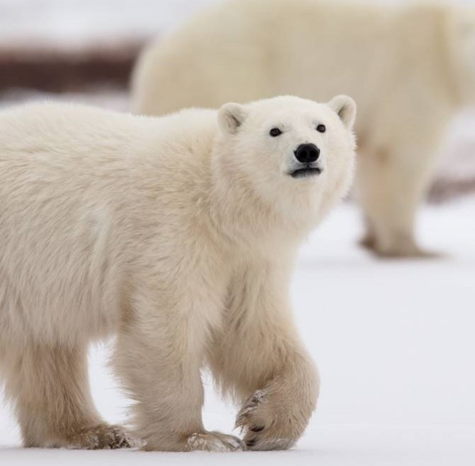
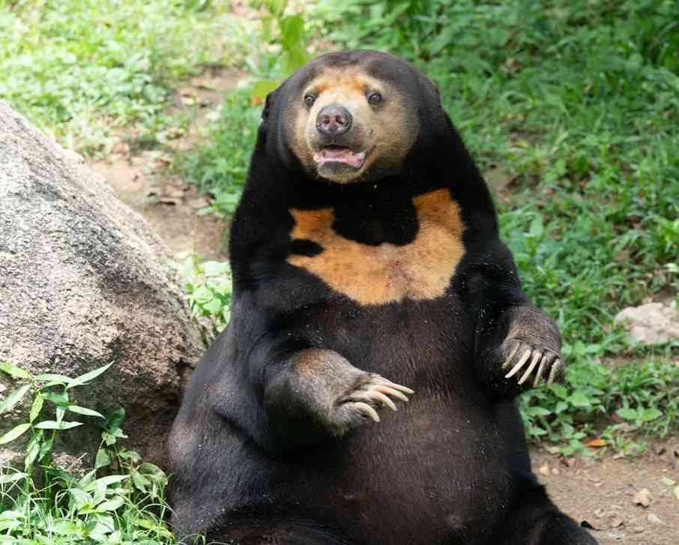
Distribution of Animals
Learning objectives
Weather vs climate
The Earth’s spheres
Creating local climates
Where are organisms?
Bergmann’s rule
Climate affects distribution of organisms
Organisms living in colder climates are larger than organisms in warmer climates
Polar Bears:
Native to the Arctic
5.9 – 8.2 ft long
4.3 – 5.2 ft tall at shoulder
500 – 1,760 lbs
Hooked claws allow climbing on ice
Thick, dense undercoat and furry paws to trap warmth close to body
White for camouflage
Sun Bears:
Native to southeast Asia
3.3 – 4.6 ft long
2.2 ft tall at shoulder
55 – 143 lbs
Long tongue to extract honey, insects, and plants
Silky, fine fur with undercoat
Inward turned front feet and large claws suited for climbing trees
Notes:
Climate also affects how animals are distributed.
Bergmann’s rule is that organisms, especially animals, that live in colder climates are larger than organisms in warmer climates.
We have two examples here – polar and sun bears.
Polar bears are native to the Arctic and thus are large, heavy, have thick fur to retain warmth, and hooked claws that allows them to climb on ice.
Sun bears, on the other hand, are native the southeast Asia, are the smallest of all bears, have a long tongue that allows them to get at insects, honey, and plants, and have specific structures, such as inward turned front feet, that allow them to climb trees to obtain food.

Slide 13
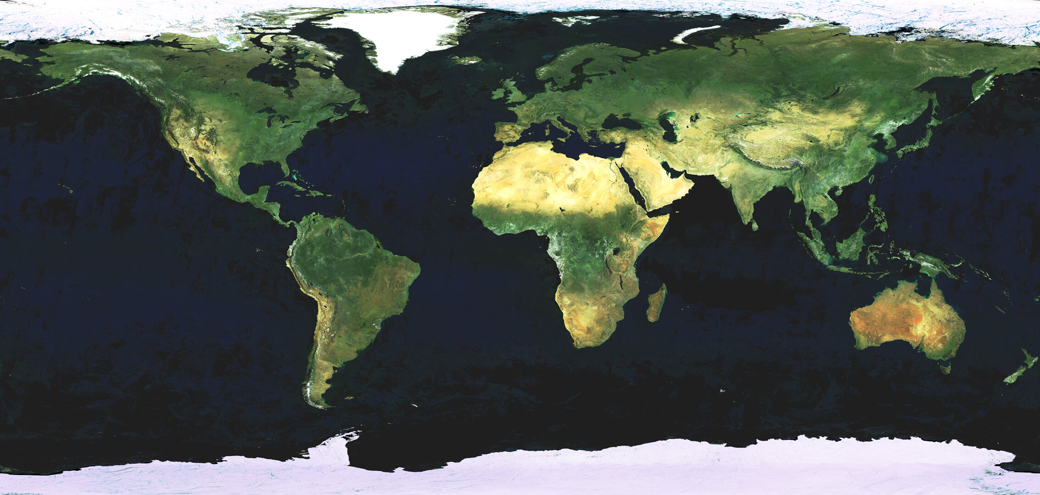
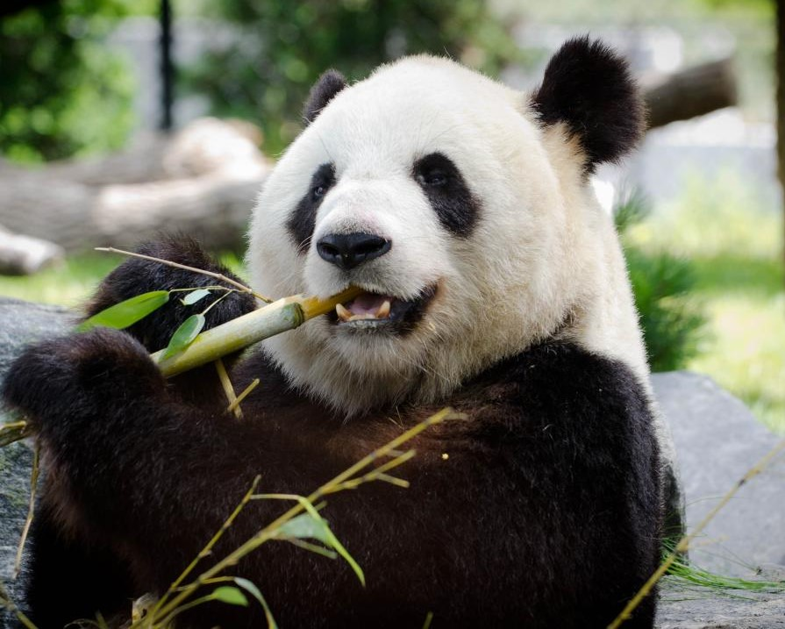
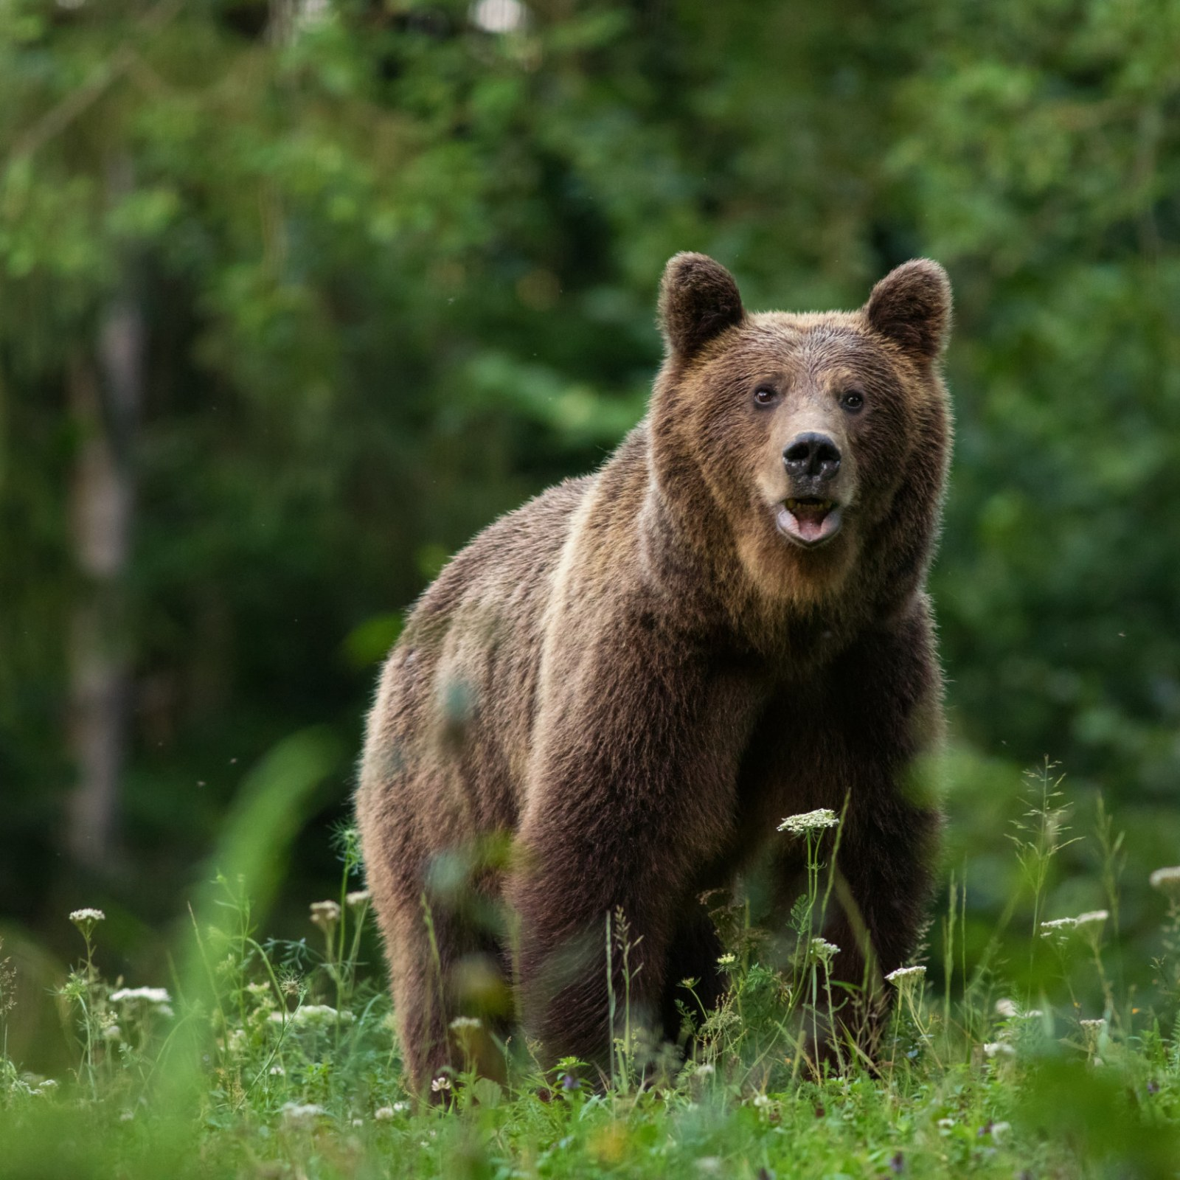
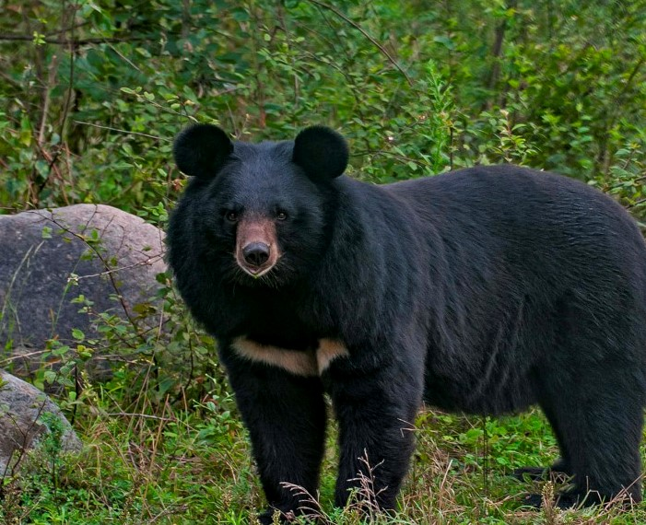
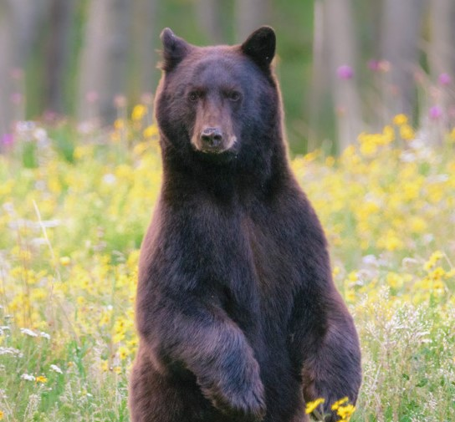
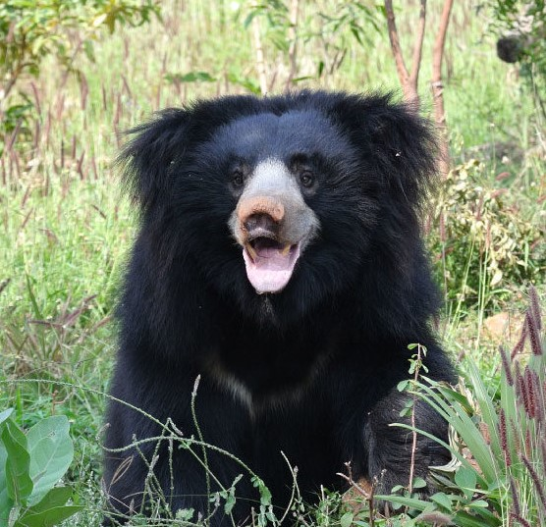
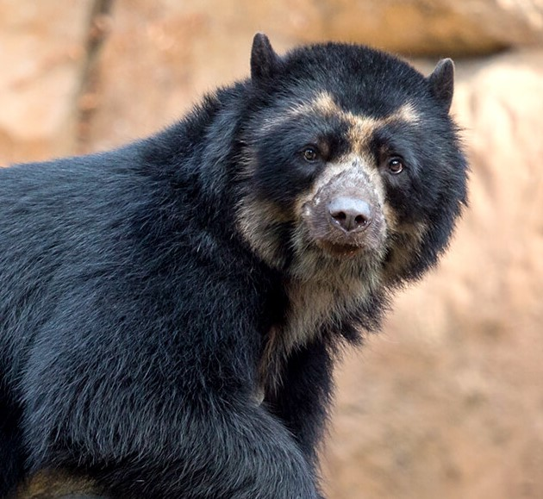
Distribution of Animals
Polar
Learning objectives
Weather vs climate
The Earth’s spheres
Creating local climates
Where are organisms?
Giant Panda
Brown
Asian Black
Black
Sloth
Spectacled
Sun
Notes:
As you can see, the large polar bear lives in high latitudes where it is very cold, whereas the smaller sun bear lives in the tropics where it is quite warm.
There are 8 major bear species. Each live in unique climates and environments. Over time, they adapted to their environment so they can best survive and thrive.

Slide 14
What factors create local climates and how does this affect distribution of species?
Learning objectives
Weather vs climate
The Earth’s spheres
Creating local climates
Where are organisms?
The Earth has four main spheres: biosphere, hydrosphere, lithosphere, and atmosphere
Local climates are created when these spheres interact
Local climates vary based on: latitude, altitude, atmospheric instability, prevailing winds, rain shadows, proximity to water, and land cover
Organisms adapt to their climate, resulting in variations in species

Slide 15
Discussion Prompts
Explain how proximity to water affects temperature.
Describe 2 – 3 different ways that plants and animals adapt to different climates.
Generally speaking, would temperature increase or decrease if:
You traveled away from the equator?
You traveled up a mountain?
A densely-populated city was built on land that was previously farmland?

Slide 16
Discussion Prompts
Sketch a mountain range. Label the windward and leeward sides of the range.
Using your sketch, explain how rain shadows occur.
Would precipitation generally increase or decrease if you travel toward a body of water?

